Slide 1
Online Shopping Management System
GROUP 8 Prof: Robin Singh

Slide 2
Team Members
Amandeep C0840378
Ajaydeep Singh C0834577
Banisha
Gurusharan Singh C0828270
Romanjit Kaur C0798336
Sandeep Kaur C0834670
Sruthy Amey Samuel C0834672

Slide 3
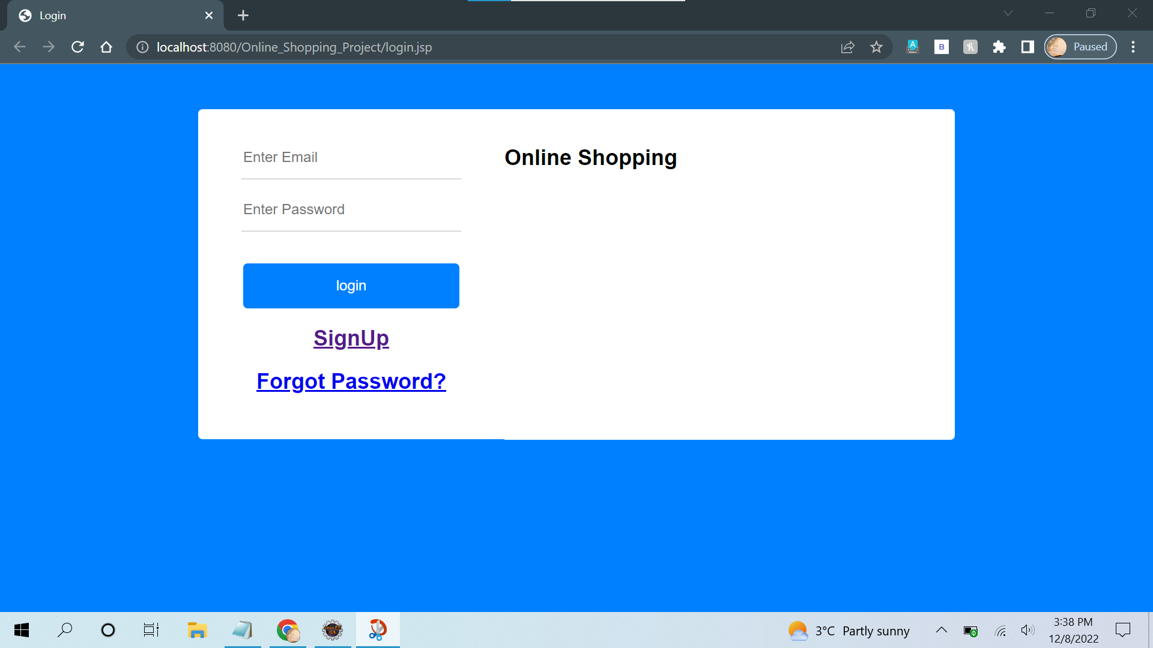

Slide 4
Admin Landing Page

Slide 5
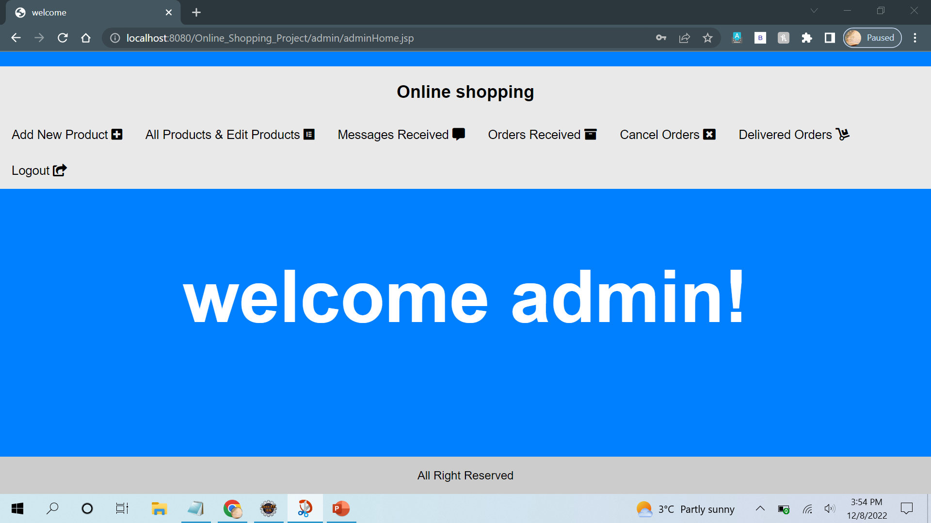
Admin Landing Page

Slide 6
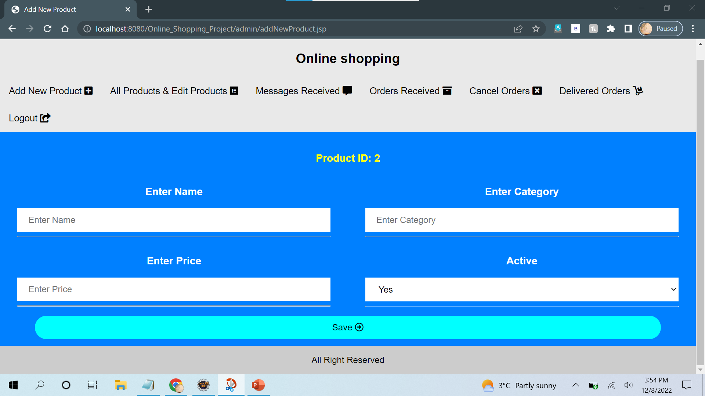
Add new Product

Slide 7
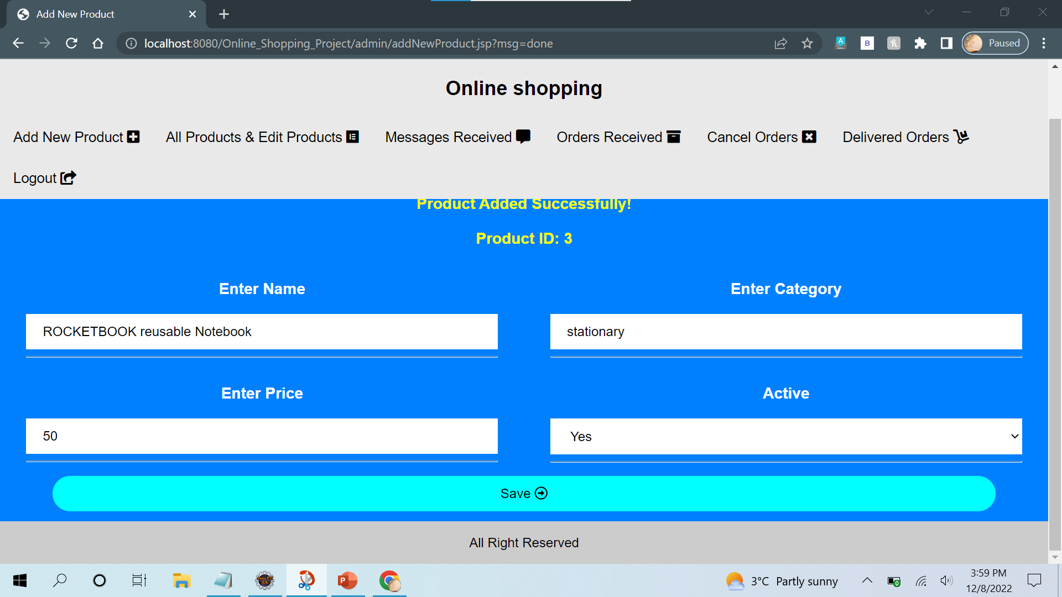
Adding a new product

Slide 8
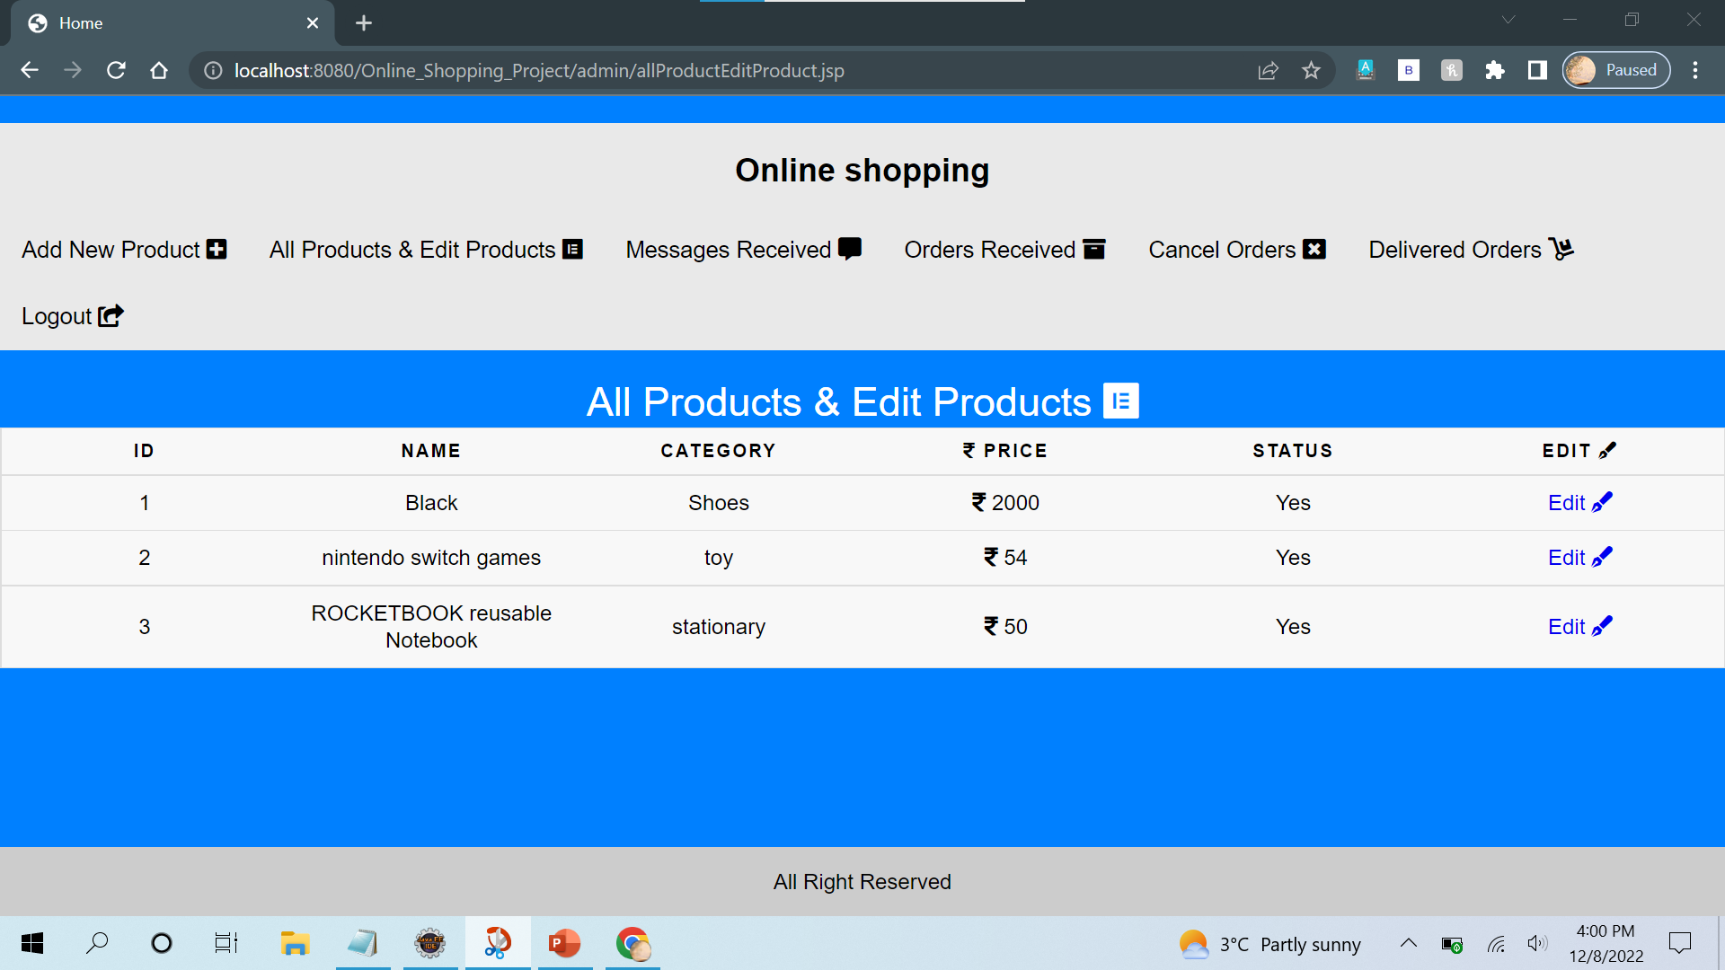
Editing the product details

Slide 9
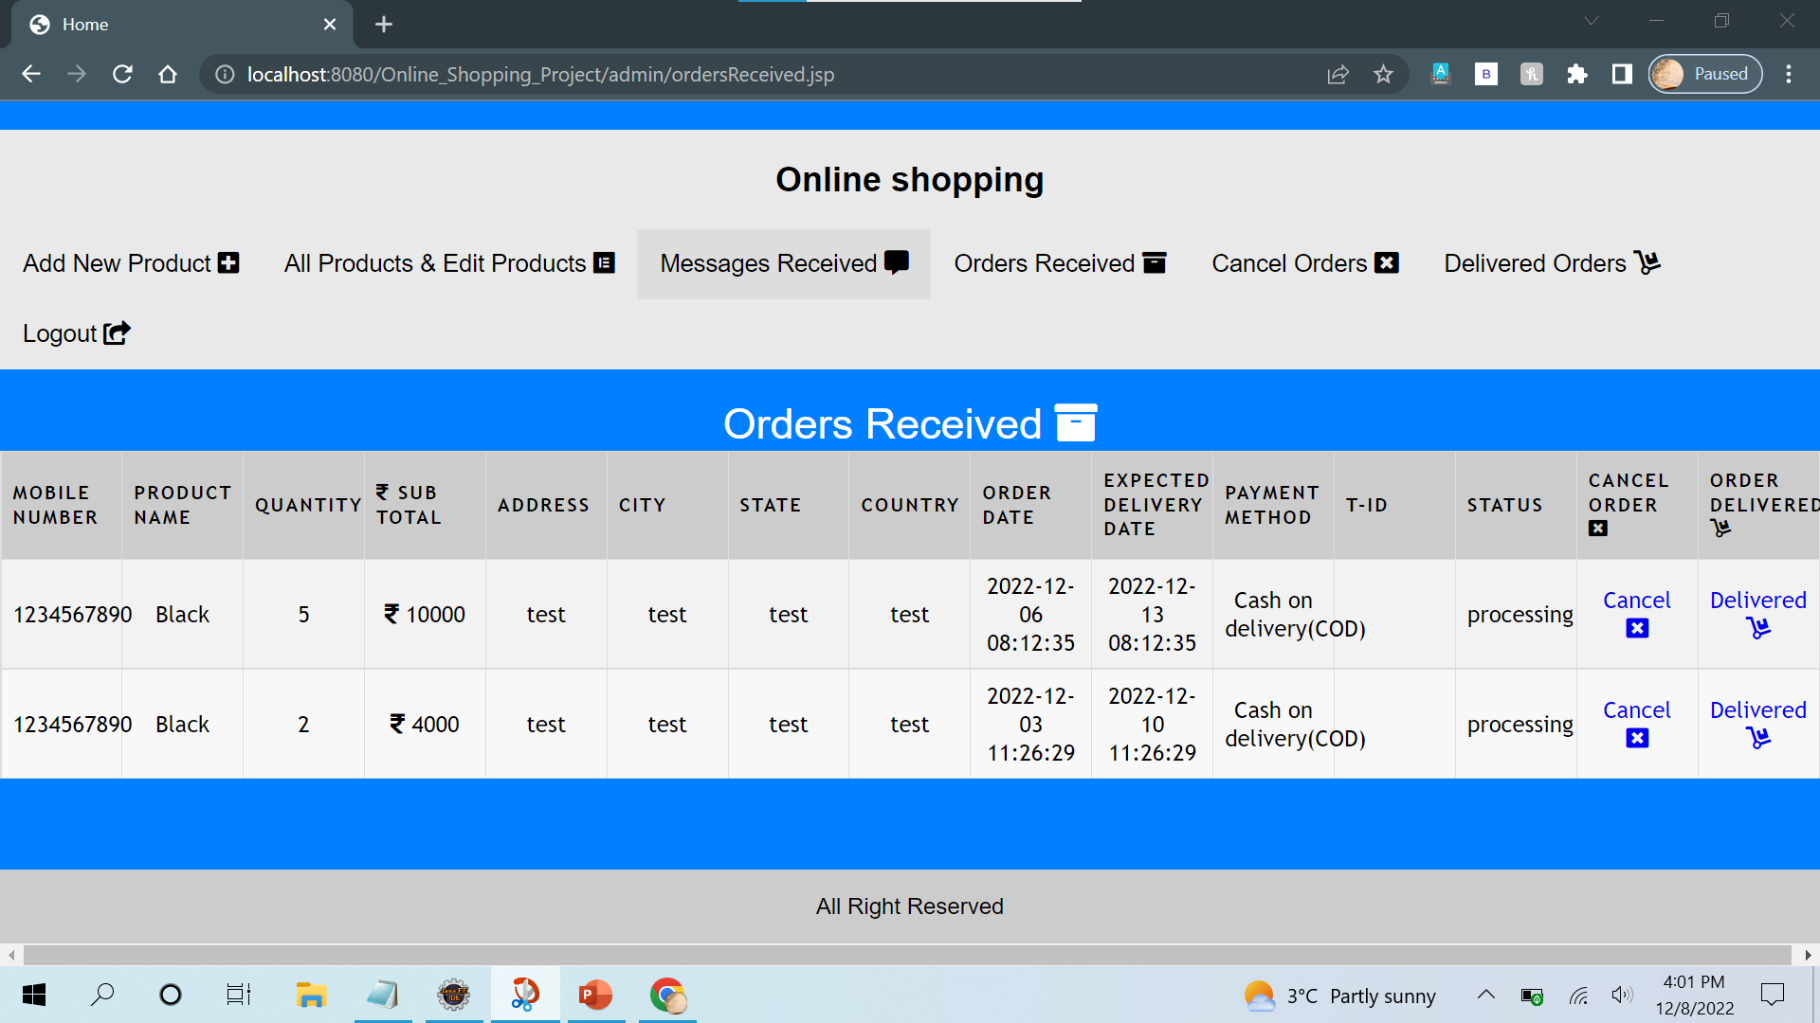
Order Received from users

Slide 10
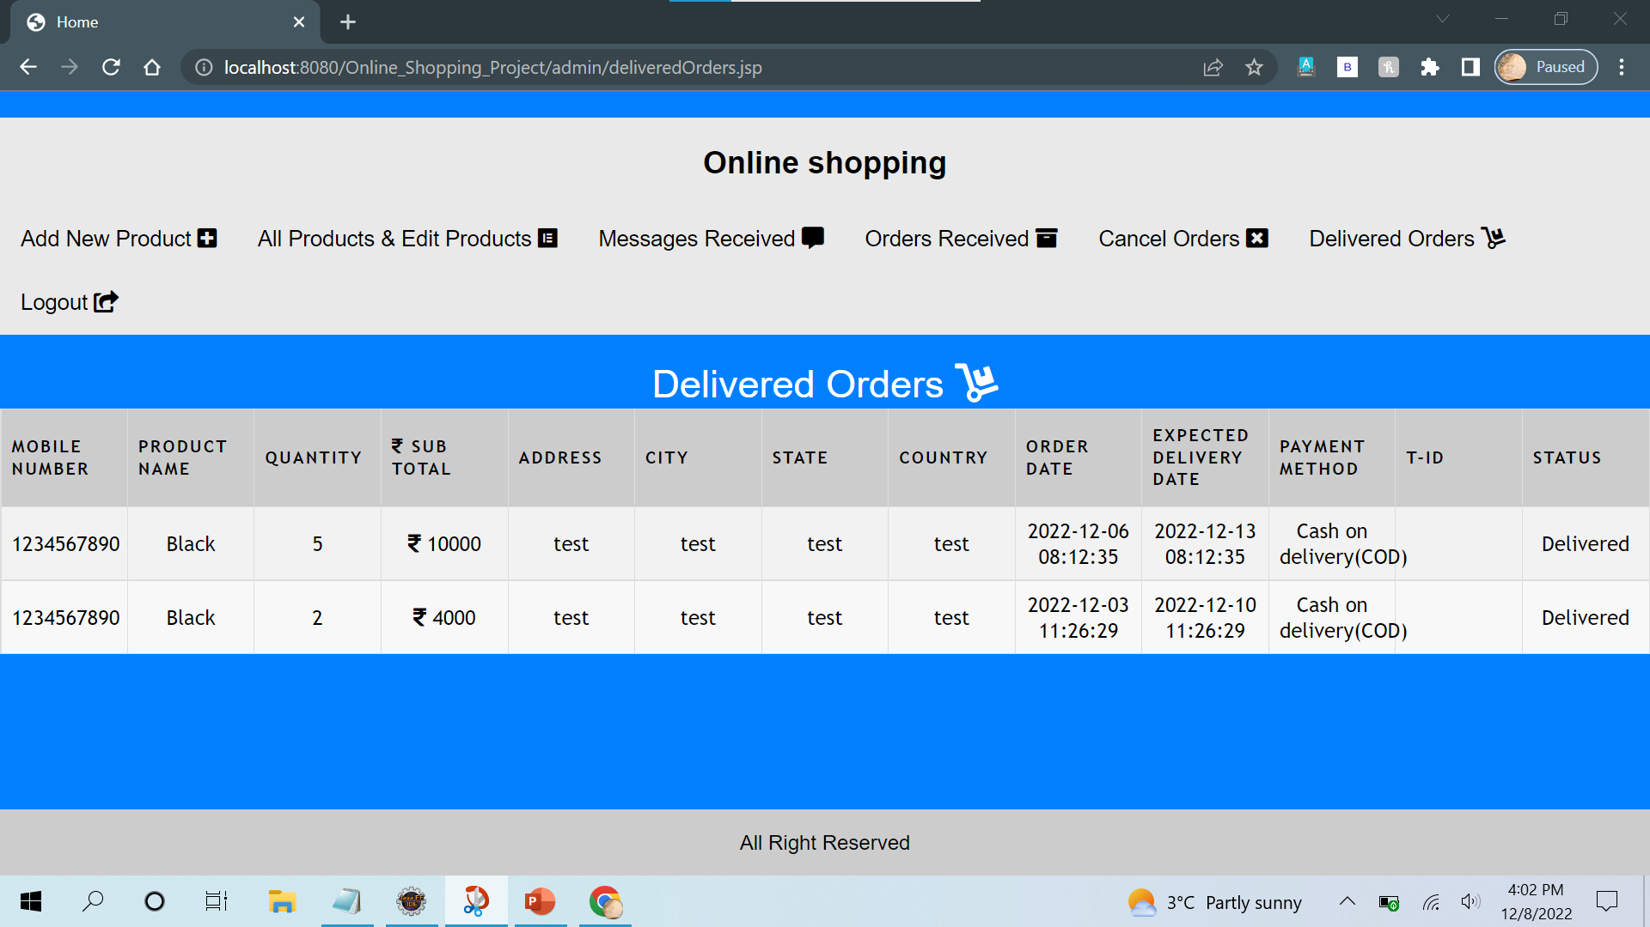
Details on Delivered Orders

Slide 11
User Landing Page

Slide 12
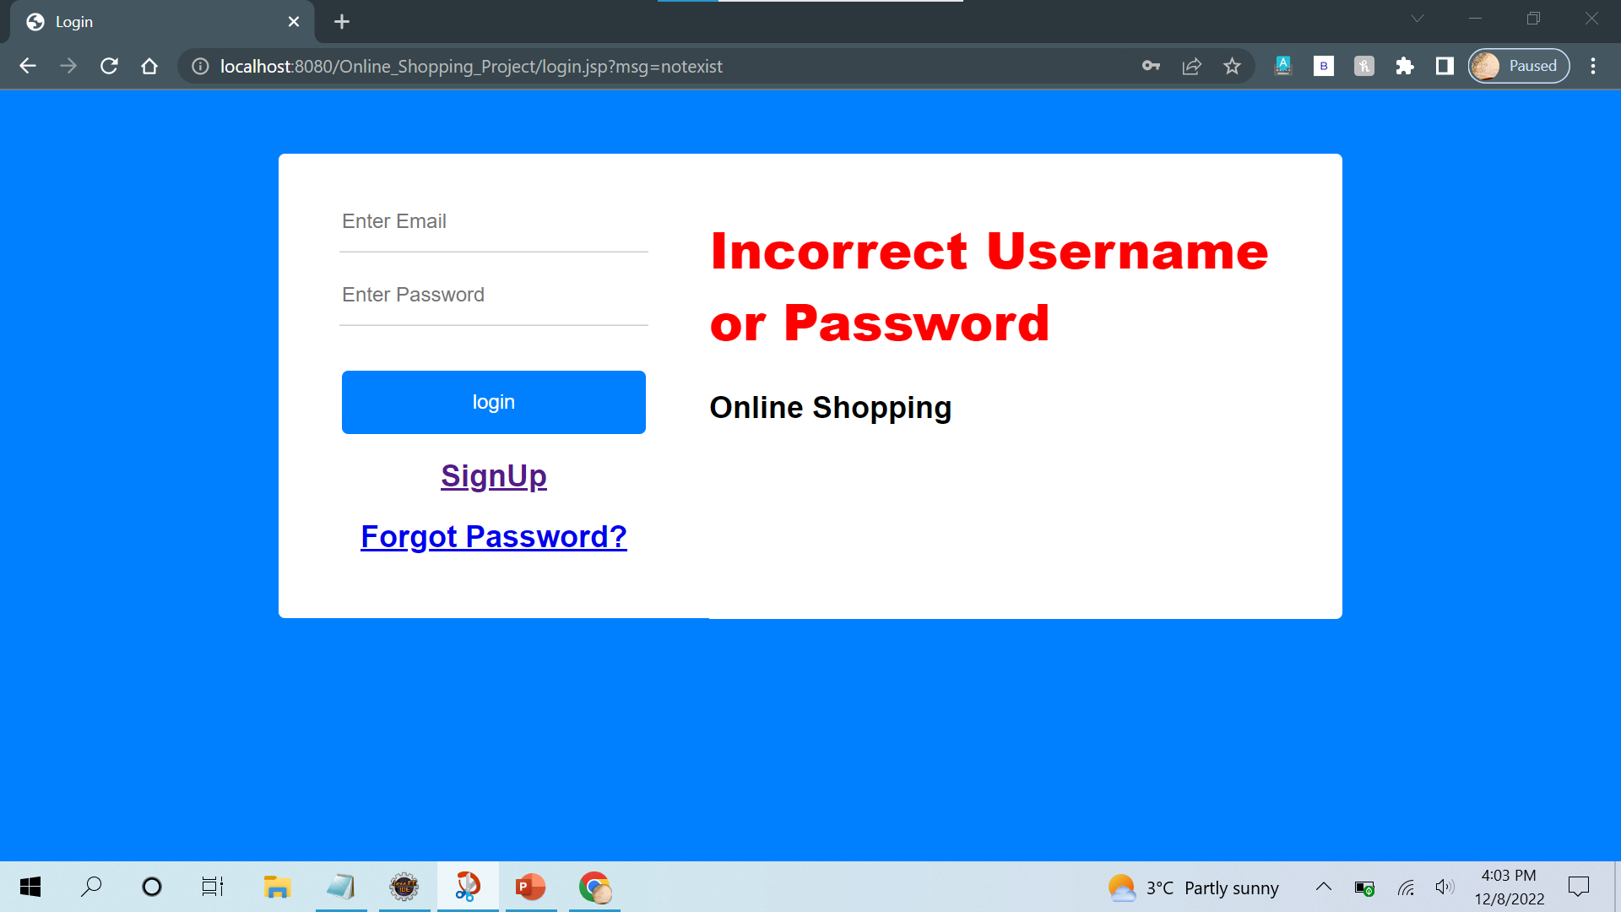
Invalid User details

Slide 13
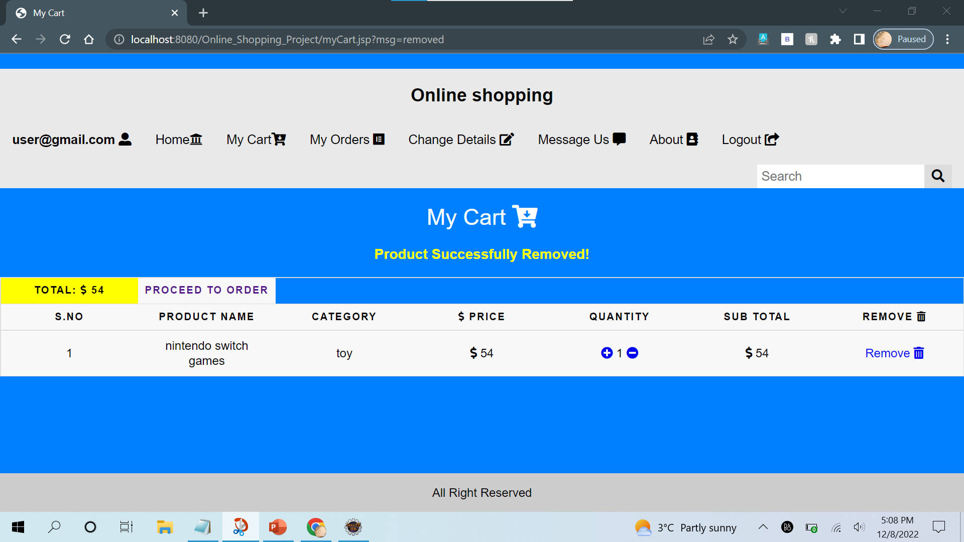
Cart of the user

Slide 14
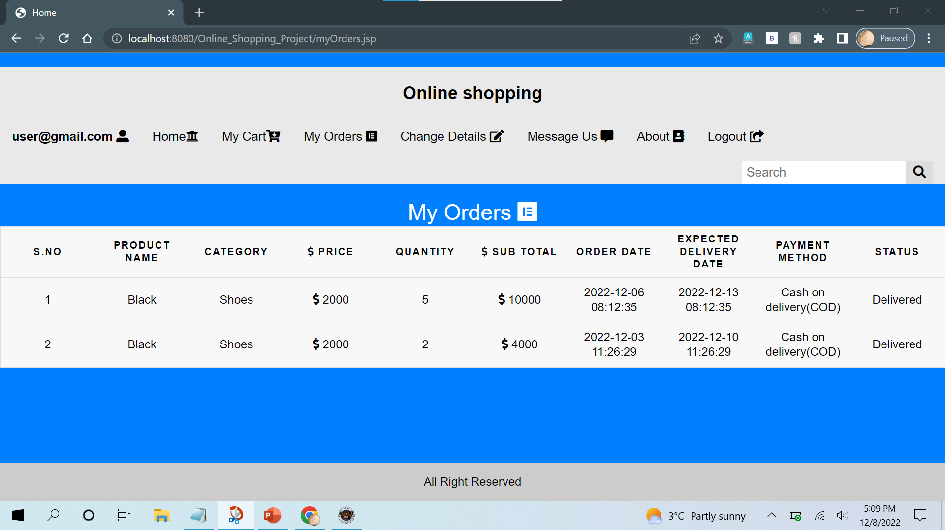
Order History of a Particular User

Slide 15
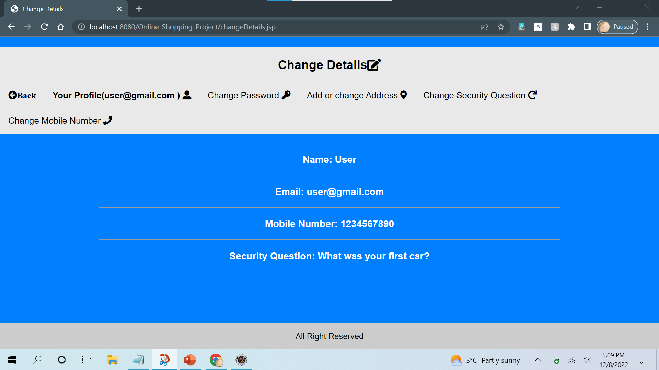
Update the details of user

Slide 16
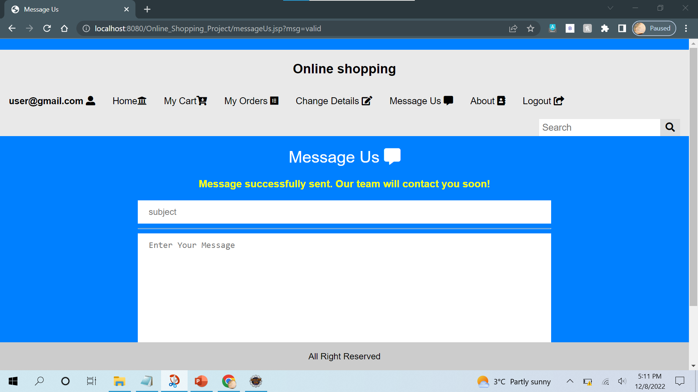
Raising the concern for the orders

Slide 17
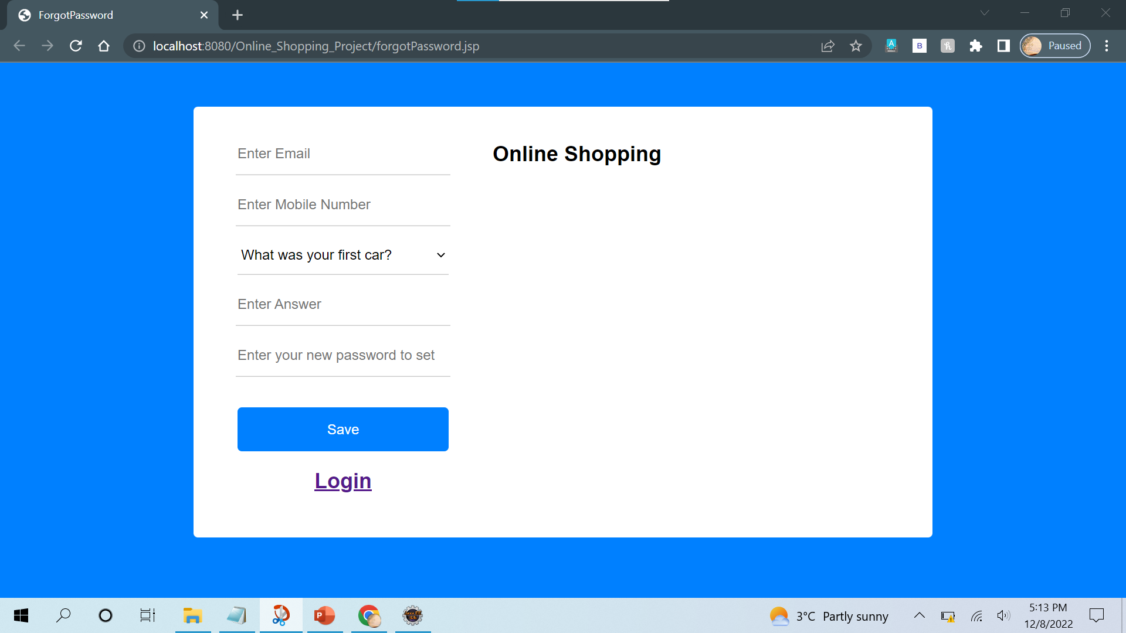
Forgot the password

